Slide 1

NETWORK ANALYSIS TEAM
SUMMARY OF OPERATIONS
MONITORING, ANALYSIS AND MITIGATION
OF A VULNERABLE NETWORK
Notes:
Henry, Privthi, and Moses

Slide 2
Table of Contents
This document contains the following resources:
Network Topology & Critical Vulnerabilities
Traffic Profile
Normal Activity
Malicious Activity
Notes:
We will be going the ….

Slide 3
Network Topology
& Critical Vulnerabilities
‹#›

Slide 4
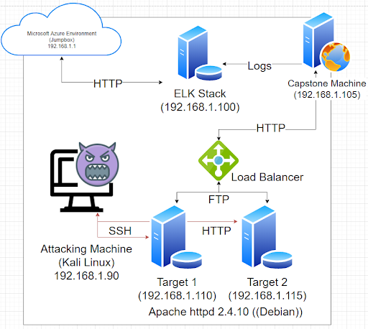
Network Topology
[Insert Here]
Use draw.io to create a diagram of the network.
Add your diagram to this slide and fill out the data in the sidebar.
Network
Address Range: 192.168.1.1/24
Netmask: 255.255.255.0
Gateway: 10.0.0.1
Machines
IPv4: 192.168.1.90
OS: Linux Kali 5.4.0-kali3
Hostname: Kali
IPv4: 192.168.1.105
OS: Ubuntu 18.04.4 LTS
Hostname: Capstone
IPv4: 192.168.1.100
OS: Ubuntu 18.04.4 LTS
Hostname: ELK
IPv4: 192.168.1.110
OS: debian 3.16.0-6-amd64
Hostname: Target 1
IPv4: 192.168.1.115
OS: debian 3.16.0-6-amd64
Hostname: Target 2
Notes:
The Network we analyzed for data.

Slide 5
Critical Vulnerabilities: Target 1 & 2
Our assessment uncovered the following critical vulnerabilities in Target 1.
Vulnerability | Description | Impact
Port 22 | ssh | With the correct credentials is able to access network
Port 111 | rpc-bind | Is used for PortMapping and is always listens on TCP/UDP.
Port 139 | netbios-ssn | An attacker is able to run NBSAT a diagnostic tool over TCP/IP
Port 445 | netbios-ssn | Is the preferred Port for Windows FileSharing and numerous other services
Notes:
Critical Vuln. we discovered during the Attack Phase.

Slide 6
Traffic Profile
‹#›

Slide 7
Traffic Profile
Our analysis identified the following characteristics of the traffic on the network:
Feature | Value | Description
Top Talkers (IP Addresses) | 172.16.4.205 - 45 million bytes 185.243.115.84 - 26 million bytes 166.62.111.64 - 16 million bytes | Machines that sent the most traffic.
Most Common Protocols | UDP - 11697 packets TCP - 92280 packets TLS - 7272 packets | Three most common protocols on the network.
# of Unique IP Addresses | 30 unique addresses discovered | Count of observed IP addresses.
Subnets | 172.16.4.0/24 | Observed subnet ranges.
# of Malware Species | 55 | Number of malware binaries identified in traffic.
Notes:
Top IP Addresses was discovered by Statistics>Endpoints>Click IPv4 and filter bytes ascending to show Top IP Addresses
Common Protocols was discovered via - Statistics>Protocol Hierarchy>Sort Packets ascending
# Unique IP - Statistics>Endpoints>Clip IPv4 or IPv6>Change to Ethernet
# Malware - After researching june11.dll it was discovered there was 55 engines detected

Slide 8
Behavioral Analysis
Purpose of Traffic on the Network
Users were observed engaging in the following kinds of activity.
“Normal” Activity
Watching Youtube
Web Browsing
Suspicious Activity
Downloading Torrents for Illegitimate Purposes
Downloading Malware

Slide 9
Normal Activity
‹#›

Slide 10
[Watching Youtube]
Summarize the following:
Two users set up a private web server on the corporate network. Their IPs are on the 10.6.12.0/24 network range. SMB2 traffic, HTTP, Browser
The employee in question was watching Youtube during work hours using an unauthorized domain controller.
Include screenshots of packets justifying your conclusions.
The IP of the Domain Controller is 10.6.12.12

Slide 11
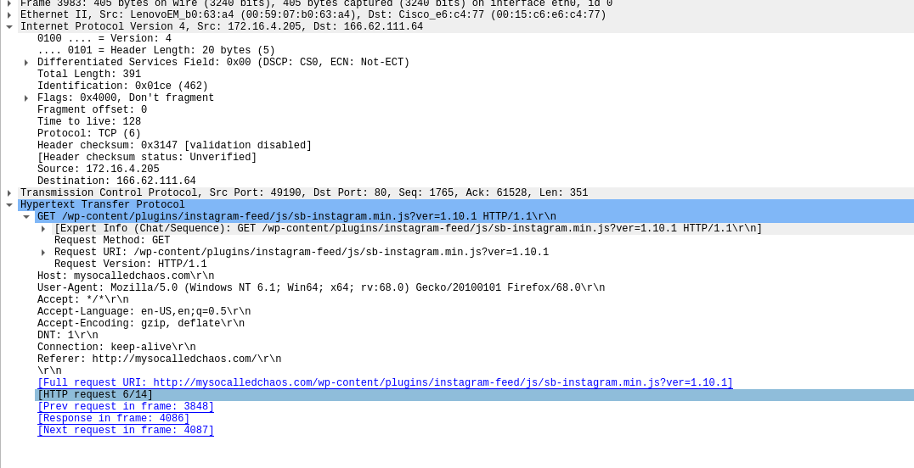


[Web Browsing]
Summarize the following:
HTTP protocol
We can see that the IP user of 172.16.4.205 is browsing blog under http://mysocalledchaos.com
The IP user is taking in a lot of .png picture files to print out for sticker use

Slide 12
Malicious Activity
‹#›

Slide 13
[Downloading Torrents]
Summarize the following:
What kind of traffic did you observe? Which protocol(s)? Typical traffic that was observed was search requests and typical keep connection alive. The Protocols observed were TCP, HTTP
What, specifically, was the user doing? Which site were they browsing? Etc. The user in question was downloading a Torrent. Not authorized by the company as it breaks copyright laws. http://files.publicdomaintorrents.com
Include screenshots of packets justifying your conclusions.
Include a description of any interesting files.
The video file in question was Betty_Boop_Rhythm_on_the_Reservation.avi

Slide 14
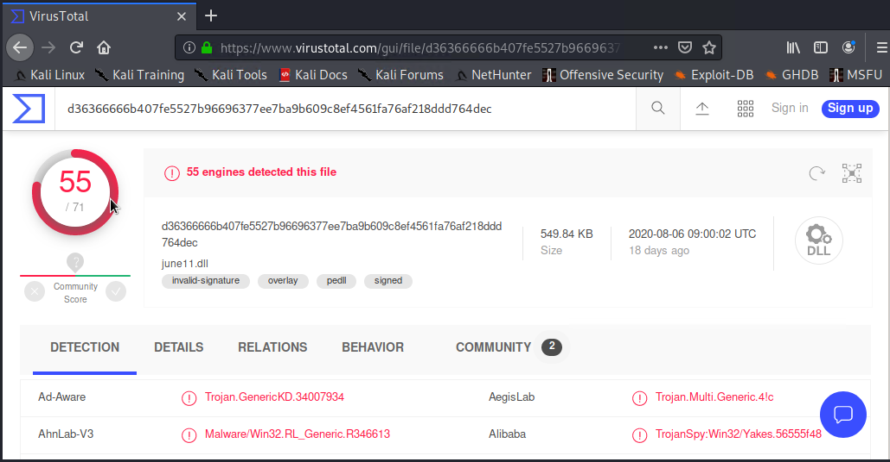
[Downloading Malware]
Summarize the following:
What kind of traffic did you observe? Which protocol(s)? TCP and HTTP
What, specifically, was the user doing? Which site were they browsing? Etc. From the data we retrieved it appears the employee was browsing and was redirected to a malicious webpage.
Include screenshots of packets justifying your conclusions.
Include a description of any interesting files.
The malware in question was june11.dll which is a Trojan.

Slide 15
The End
‹#›

